Slide 1
COLOR DETECTION IN AN IMAGE
USING OPENCV AND PANDAS

Slide 2

Aim of this program to identify colour of every pixel in an image using opencv and pandas.
It can identify upto 16 million different type of colours if provided the CSV file.

Slide 3
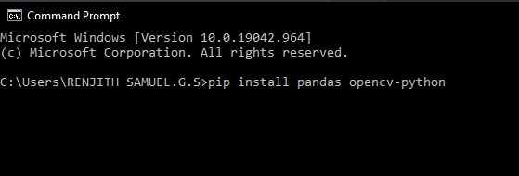
Step 1
Install opencv and pandas modules using command prompt.

Slide 4

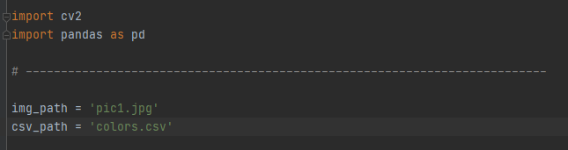
2)Import the modules in the python interpreter then read the image and the respective csv file. [A CSV (comma-separated values) file is a text file that has a specific format which allows data to be saved in a table structured format.

Slide 5

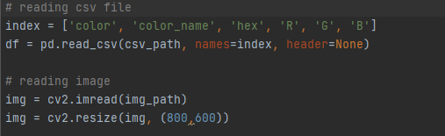
The csv file and image must be modified to suit our application also indexing the CSV file is necessary

Slide 6

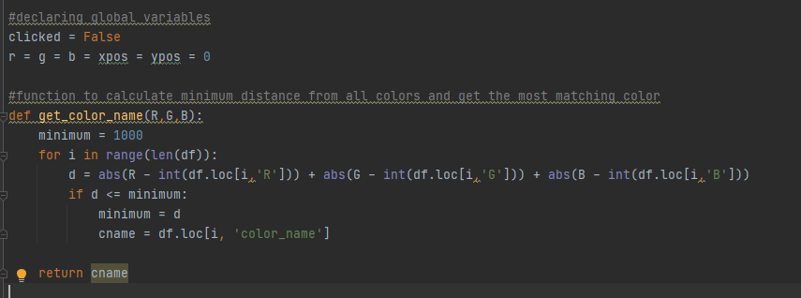
4)creating a function to calculate colour name from the CSV file.

Slide 7

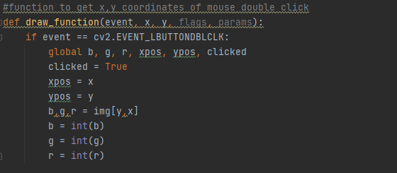
5)creating a function for user interface in order to pinpoint a pixel and retrieve colour information.

Slide 8

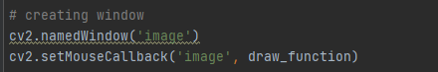
6) creating a window using cv2(colour vision library) in which the colour information of a pixel exists.

Slide 9

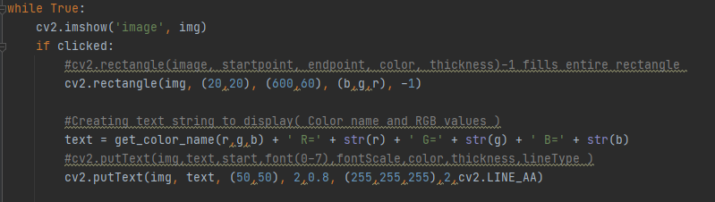
7) adding left mouse button to select the pixel of the image of the interface. Adding function call back to get the colour name to be displayed on the window.

Slide 10

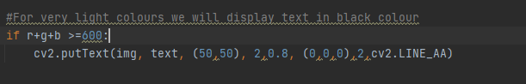
8)since the text won’t be readable if the background colour is same as the text colour we need to change the colour of the text depending on the background.

Slide 11

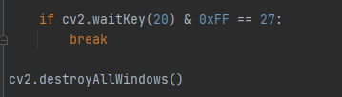
9) closing the window if no interactions within 20 secs or using escape key.

Slide 12
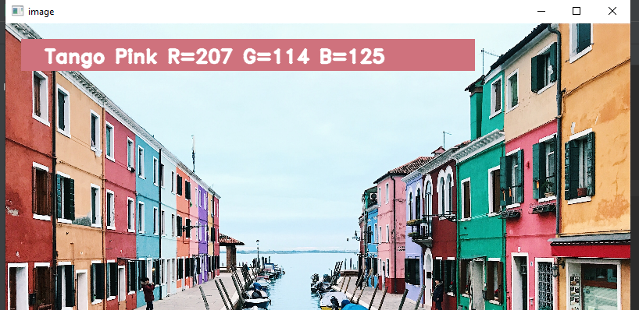
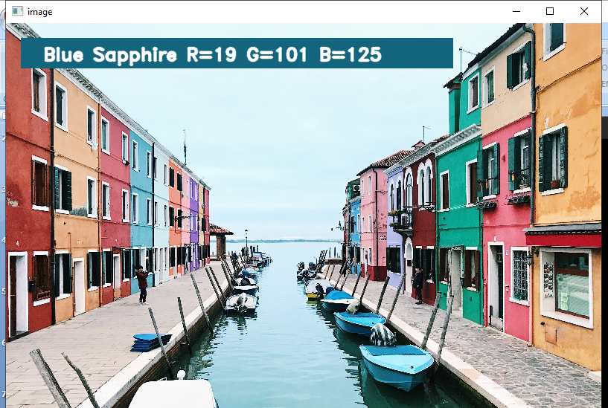
OUTPUT RESULT:

Slide 13
PREDICTED APPLICATIONS:
display calibration
food & beverage processing
automobiles
colour production
paints
textures

Slide 14
THANK YOU!
Done by:
RENJITH SAMUEL G S – CSE
DHARANEESH J – CSE
SRI DHARSHAN – CSE
JAI KRISHNAN A – CSE
ARUN P R - CSE

